Slide 1

Online Library Management System

Slide 2
1.Introduction
Online library management systems have revolutionized how libraries operate. These digital platforms offer a seamless way to manage collections, automate workflows, and provide enhanced services to users.

Slide 3
2.Existing system and dis-advantages
Time Consumption: Manual record keeping and searching for books and members can be time-consuming, taking away from other important tasks.
Data Loss: The existing system is prone to data loss due to hardware failure, natural disasters, or human error.
Limited Access: The existing system may not provide 24/7 access to library resources, limiting the availability of information to students and staff.
Security Risks: The existing system may be vulnerable to security risks, such as data breaches and unauthorized access.
Limited Reporting: The existing system may not provide real-time reporting

Slide 4
3.Problem statement
Key Challenges:
Resource Management: Efficiently cataloging books, journals, digital media, and other materials, ensuring accurate inventory tracking and availability status.
User Management: Facilitating user registration, managing memberships, and providing personalized services such as recommendations and notifications.
Transaction Handling: Handling checkouts, reservations, renewals, and returns seamlessly while maintaining accuracy in records.
Search and Accessibility: Providing an intuitive interface for users to search and access resources, including advanced search options and filters.
Security and Privacy: Ensuring data security, protecting user information, and preventing unauthorized access to library resources

Slide 5
4.Proposed System And Advantages
Security: The system will ensure the security and integrity of library data, protecting sensitive information and preventing unauthorized access.
Real-time Tracking: The system will provide real-time updates on book availability.
Cost-Effective: The system will reduce the need for manual labor, paper records, and other resources, resulting in cost savings for the library.
Improved Accuracy: The system will minimize errors and inaccuracies in book tracking.

Slide 6
5.Requirement analysis
1. User Management:
User Registration and Authentication:
Allow users to register online with basic information.
2.Catalog Management:
Resource Catalog:
Maintain a comprehensive database of library resources (books, journals, digital media, etc.).
3.Circulation Management:
Borrowing and Returns:
Facilitate check-in and check-out processes for physical and digital items.
4.Administrative Tools:
Dashboard and Analytics:
Provide administrators with a dashboard for system monitoring and management.
5.Communication and Notifications:
Notifications:
Notify users about overdue items, reservations, and system updates.
6.Security and Privacy:
Data Security:
Ensure secure storage and transmission of user data.
7.Support and Maintenance:
Support Services:
Provide technical support for users and administrators.

Slide 7
6.Design

Slide 8
7.Implementation
Graphical User Interface (GUI)
The code uses tkinter widgets to create a user-friendly interface for interacting with the library management system.
Database Management
Database Schema: It defines a table to store book details, including availability status book available or Not.
User Interaction
It is used to display informative messages, confirmations and error alerts to users during operations.

Slide 9
8.Feasibility study

Slide 10
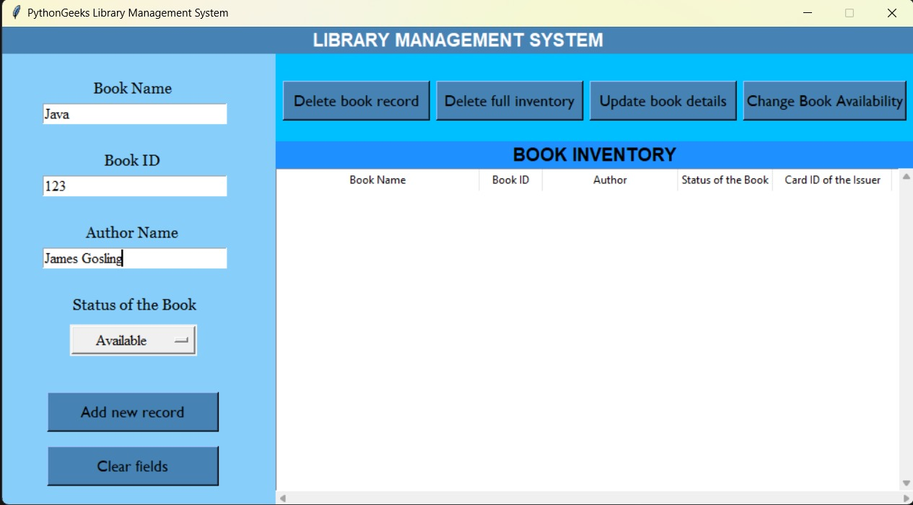
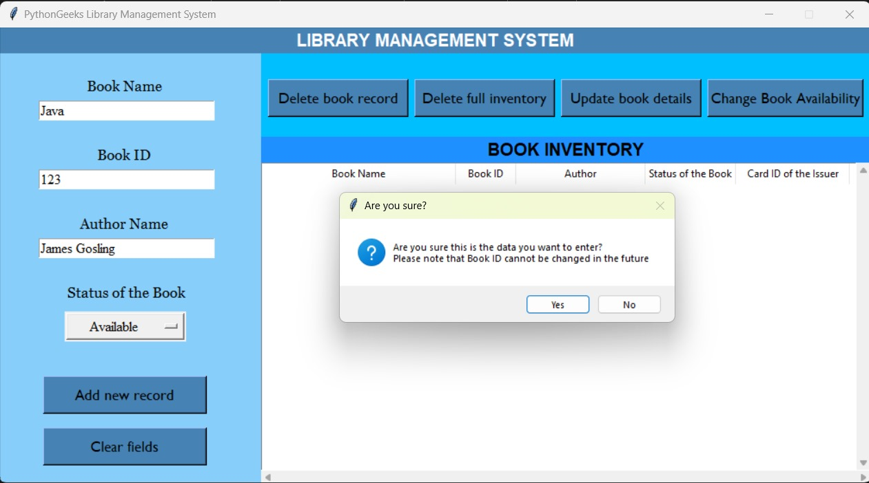
9.Output

Slide 11
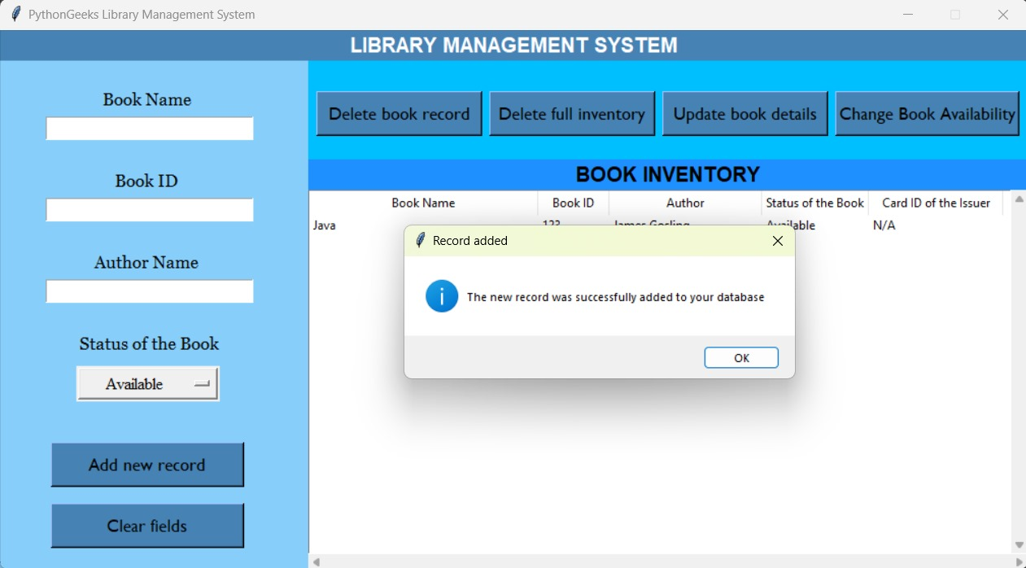

Slide 12
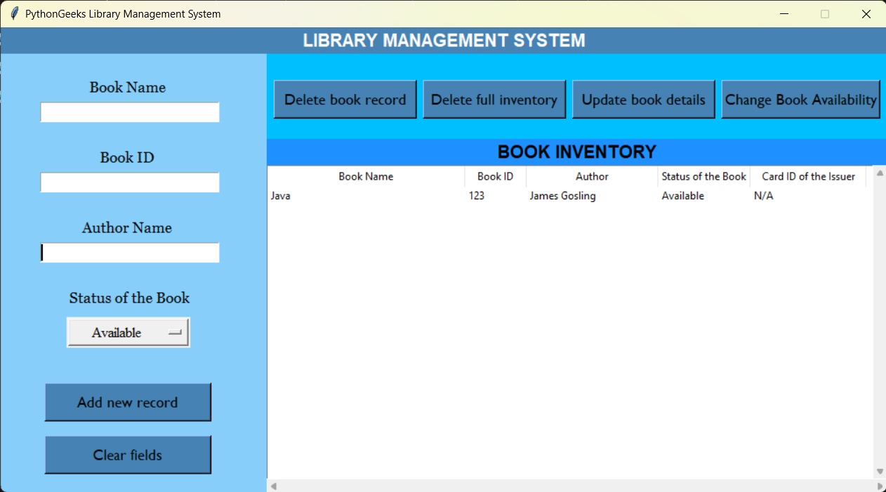

Slide 13
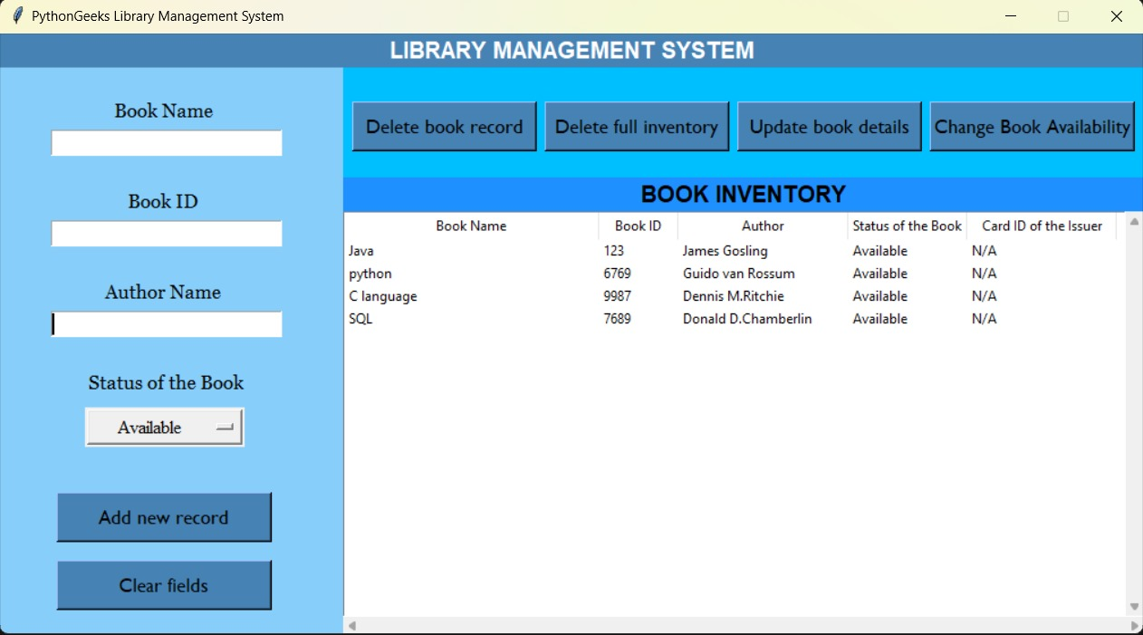

Slide 14
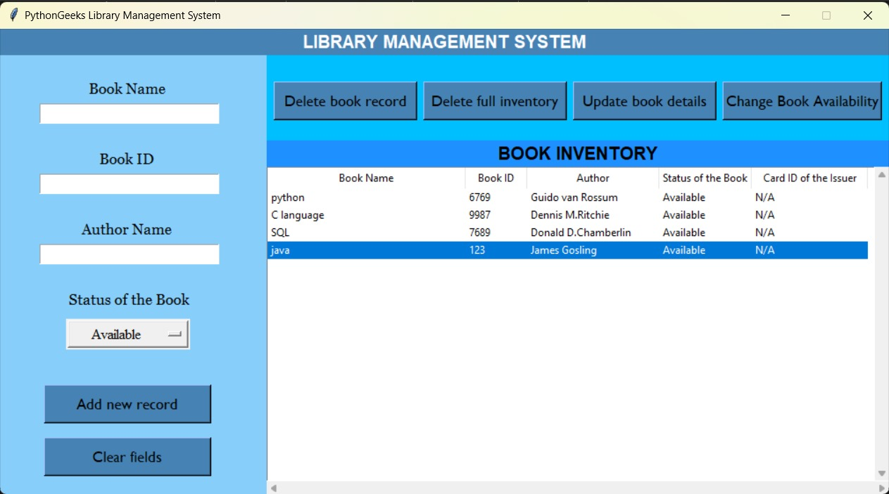

Slide 15
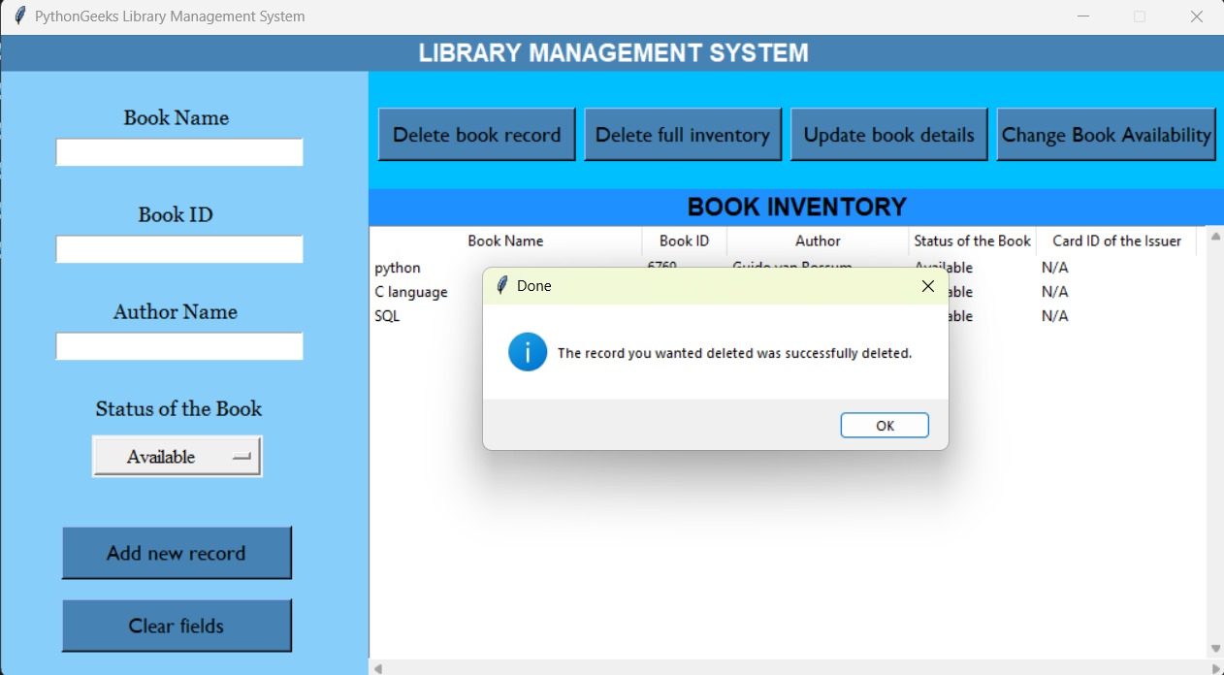

Slide 16
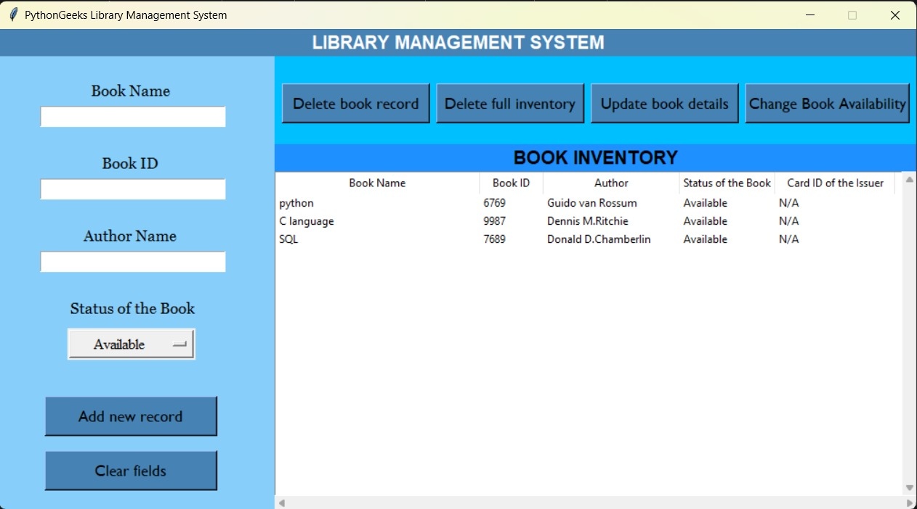

Slide 17


Slide 18
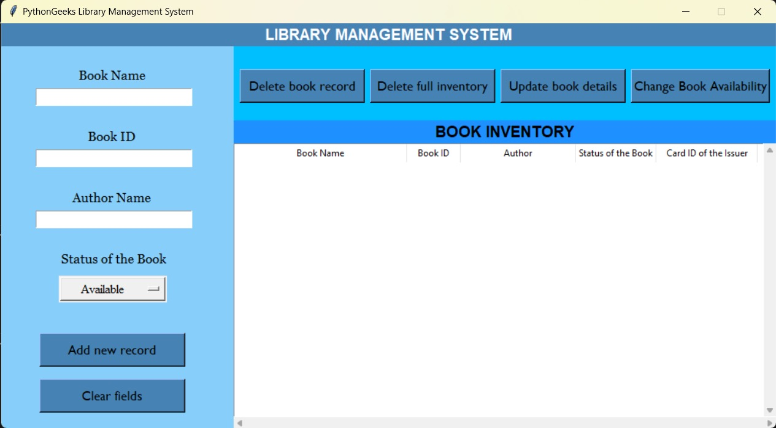

Slide 19
10.Conclusion And Future Scope
In conclusion, the online library management system offers numerous benefits such as improved accessibility, enhanced organization, and efficient resource management.
This system allows users to conveniently access library resources from anywhere at any time, making it easier for students, faculty, and researchers to conduct their work efficiently.
Overall, the implementation of an online library management system is crucial for modern libraries to stay relevant, competitive, and responsive to the evolving needs of their users in the digital age.

Slide 20
11.References
'c:\Users\koush\AppData\Local\Programs\Python\Python312\python.exe''c:\Users\koush\.vscode\extensions\ms-python.debugpy-2024.6.0-win32-x64\bundled\libs\debugpy\adapter/../..\debugpy\launcher' '65381' '--' 'C:\Users\koush\AppData\Local\Temp\f1c36425-2d4e-42b6-bab4-4cf83635dd7c_library-management-system-python-project (1) (1).zip.d7c\main.py'

